Slide 1

IE 260 – ENGINEERING ECONOMY Chapter 3 Cost Estimation Techniques
U. MAHİR YILDIRIM

Slide 2
Chapter 3
The objective of Chapter 3 is to present an assortment of methods for estimating important factors in an engineering economy study.

Slide 3
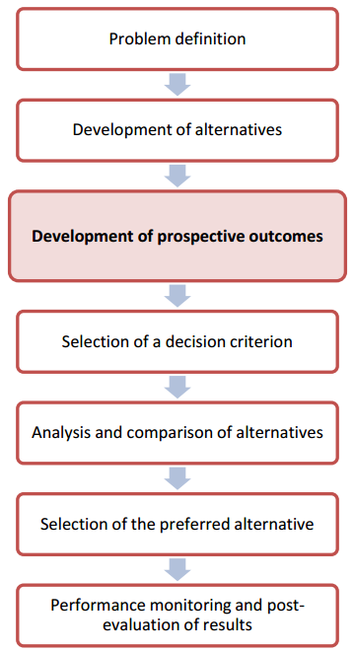
Introduction
In Chapter 1, we described the engineering economic analysis procedure in terms of seven steps. In this chapter, we address Step 3, development of the outcomes and cash flows for each alternative.
We introduce the role of cost estimating in engineering practice.

Slide 4
Development of prospective outcomes
Estimating the future cash flows for feasible alternatives is a critical step in engineering economy studies.
Estimating costs, revenues, useful lives, and other pertinent data can be the most difficult, expensive, and time-consuming part of the study.

Slide 5
Results of cost estimating are used for a variety of purposes
Setting selling prices for quoting, bidding, or evaluating contracts.
Determining if a proposed product can be made and distributed at a profit.
Evaluating how much capital can be justified for changes and improvements.
Setting benchmarks for productivity improvement programs

Slide 6
Cost Estimating 2 fundamental approaches
The top-down approach
Top-down uses historical data from similar projects. It is best used when alternatives are still being developed and refined.
Focuses on “what should the product cost” instead of “what does the product cost,” with the aim of designing costs out of products before they enter the manufacturing process. Costs are viewed as an input to the design process.
The bottom-up approach
a more detailed method of cost estimating. Usually works best when the detail concerning the desired output (a product or a service) has been defined and clarified.
breaks down a project into small, manageable units and estimates their economic consequences.
commonly used to make decisions about what to produce and how to price products

Slide 7
Example Estimating the Cost of a College Degree - top-down approach
Forecast the expense of getting a Bachelor of Science (B.S.) from the university you are attending.
A top-down approach would take the published cost of a four-year degree at the same (or a similar) university and adjust it for inflation and extraordinary items that an incoming student might encounter.
For example, suppose that the published cost of attending your university is $15,750 for the current year.
This figure is anticipated to increase at the rate of 6% per year and includes fulltime tuition and fees, university housing, and a weekly meal plan.
Not included are the costs of books, supplies, and other personal expenses. For our initial estimate, these “other” expenses are assumed to remain constant at $5,000 per year.

Slide 8
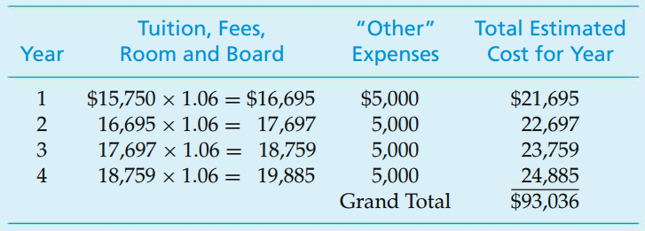
Example Estimating the Cost of a College Degree - top-down approach (cont’d)
The total estimated cost for four years
Adjust the published cost for inflation each year and add in the cost of “other” expenses

Slide 9
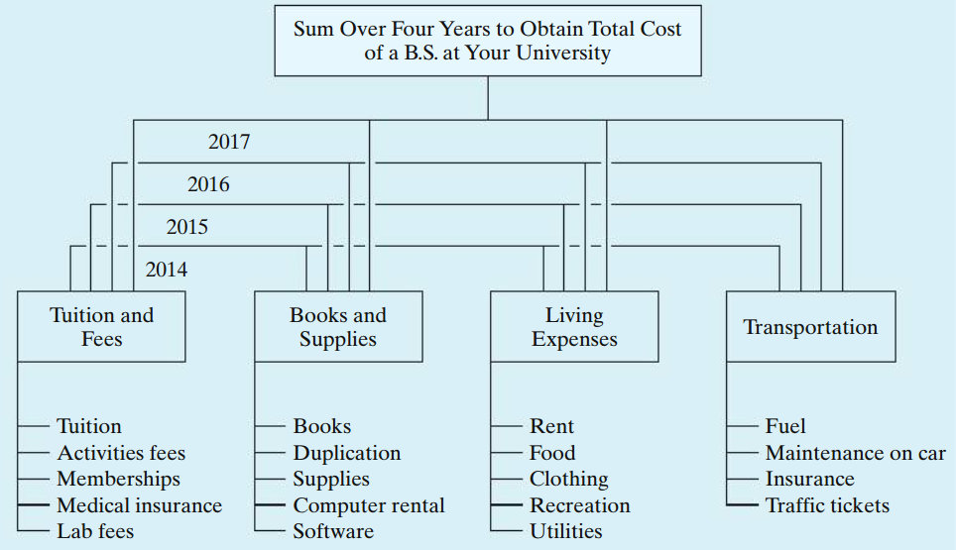
Example Estimating the Cost of a College Degree – bottom-up approach
First break down anticipated expenses into the typical categories
2019
2018
2017
2016

Slide 10
The Integrated Cost Estimation Approach 3 basic components
Work breakdown structure (WBS)
Cost and revenue structure (classification)
Estimating techniques (models)
Three basic components, together with integrating procedural steps, provide an organized approach for developing the cash flows for the alternatives.

Slide 11

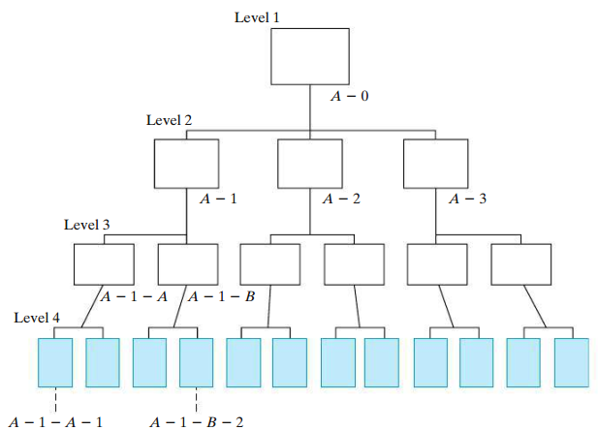
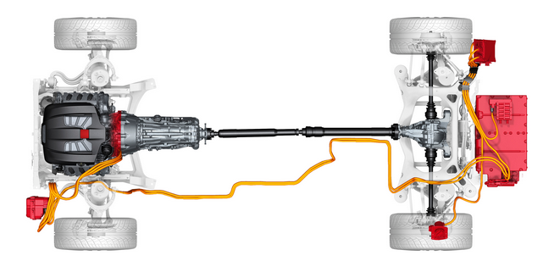
The Work Breakdown Structure (WBS)
This is a technique for
explicitly defining,
the work elements of a project
their interrelationships
developing relevant cost and revenue data

Slide 12
The Work Breakdown Structure (WBS) (cont’d)
Each level of a WBS divides the work elements into increasing detail.
Both functional and physical work elements are included.
The content and resource requirements for a work element are the sum of the activities and resources of related sub-elements below it.
A project WBS usually includes recurring and nonrecurring work elements.

Slide 13
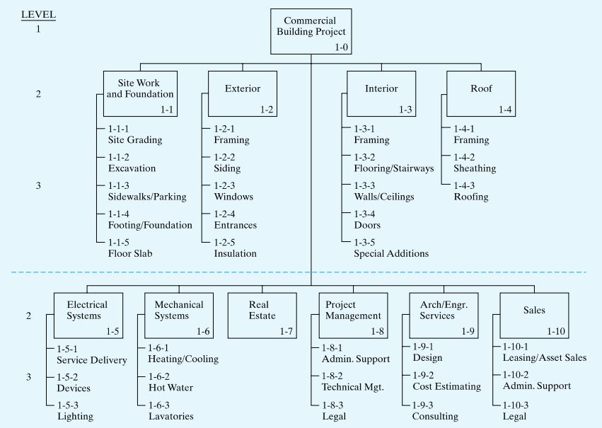
Solution A WBS for a Construction Project

Slide 14
The Cost and Revenue Structure
This structure is used to identify and categorize the costs and revenues for estimates of cash flows at each level of the WBS.
Some categories of costs and revenues that are typically needed in an
Capital investment (fixed and working)
Labor costs
Material costs
Maintenance costs
Property taxes and insurance
Overhead costs
Disposal costs
Revenues based on sales, etc.
Quality (and scrap) costs
Market (or salvage) values

Slide 15

Estimating
The purpose of estimating is to develop cash-flow projections -not to produce exact data about the future, which is virtually impossible.
Cost and revenue estimates can be classified according to detail, accuracy, and their intended use.

Slide 16

Cost and revenue estimates
Accuracy Range
Order-of-magnitude estimates: used in the planning and initial evaluation stage of a project.
Semidetailed, or budget, estimates: used in the preliminary or conceptual design stage of a project.
Definitive (detailed) estimates: used in the detailed engineering/construction stage of a project.
±30%
±15%
±5%

Slide 17
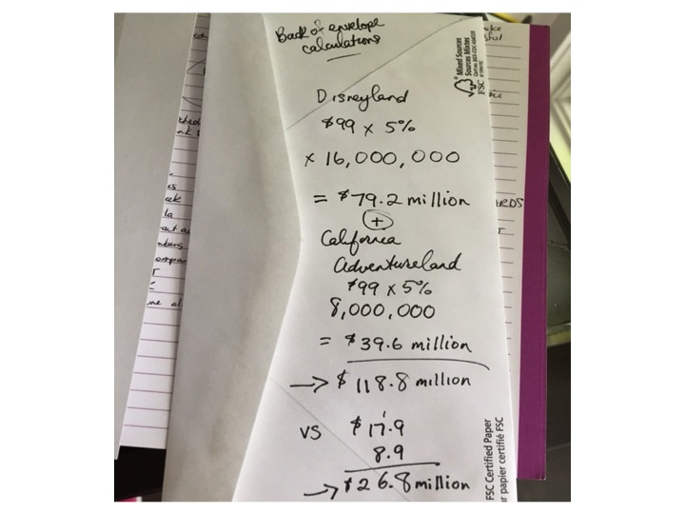
Accuracy of the estimates
A cost or revenue estimate can vary from a “back of the envelope” calculation by an expert to a very detailed and accurate prediction of the future prepared by a project team.
Depends on;
Time and effort available as justified by the importance of the study
Difficulty of estimating the items in question
Methods or techniques employed
Qualifications of the estimator(s)
Sensitivity of study results to particular factor estimates

Slide 18
Sources of Estimating Data
Accounting records
good for historical data, but limited for engineering economic analysis.
Other sources inside the firm
e.g., sales, engineering, production, purchasing.
Sources outside the firm
government data, industry surveys, trade journals, and personal contacts.
Research and development
e.g., pilot plant, test marketing program, surveys.

Slide 19
Estimating Techniques (Models)
Indexes
Unit technique
Factor technique

Slide 20
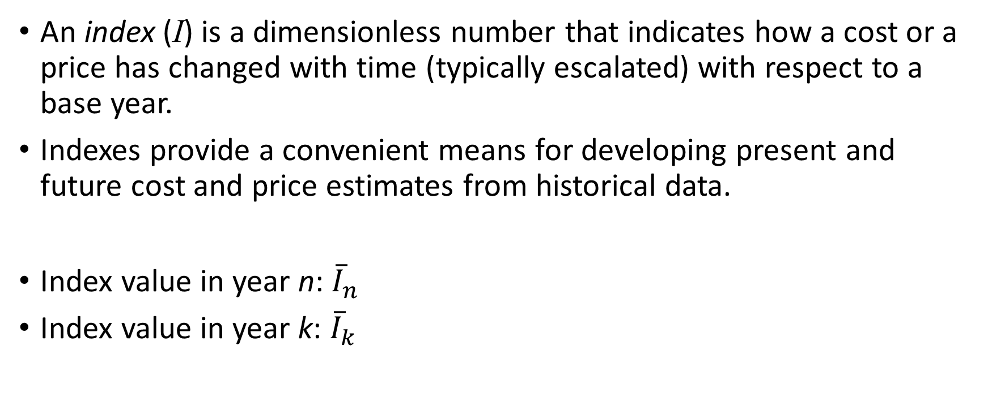
Estimating Techniques (Models) Indexes
An index (I) is a dimensionless number that indicates how a cost or a price has changed with time (typically escalated) with respect to a base year.
Indexes provide a convenient means for developing present and future cost and price estimates from historical data.
Index value in year n: ${\overline{I}}_{n}$
Index value in year k: ${\overline{I}}_{k}$

Slide 21
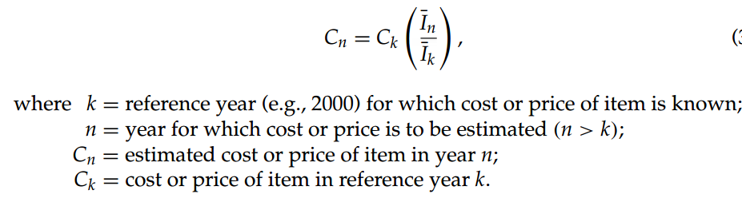
Estimating Techniques (Models) Indexes (cont’d)

Slide 22
Example Indexing the Cost of a New Boiler
A certain index for the cost of purchasing and installing utility boilers is keyed to 1990, where its baseline value was arbitrarily set at 100. Company XYZ installed a 50,000-lb/hour boiler for $525,000 in 2002 when the index had a value of 468. This same company must install another boiler of the same size in 2016. The index in 2016 is 542. What is the approximate cost of the new boiler?

Slide 23

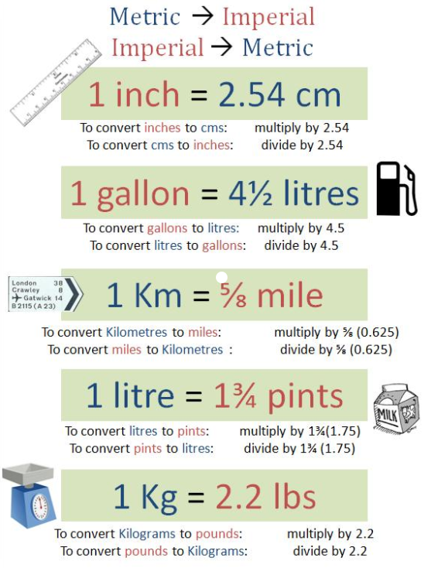

Slide 24
Example Indexing the Cost of a New Boiler
A certain index for the cost of purchasing and installing utility boilers is keyed to 1990, where its baseline value was arbitrarily set at 100. Company XYZ installed a 50,000-lb/hour boiler for $525,000 in 2002 when the index had a value of 468. This same company must install another boiler of the same size in 2016. The index in 2016 is 542. What is the approximate cost of the new boiler?
Solution
n = 2016, k = 2002 → C₂₀₁₆ = $525,000 (542/468) = $608,013

Slide 25
An index example from Turkey?
Consumer price index (CPI)
Tüketici fiyat endeksi (TÜFE)
a composite price index that measures average change in the prices paid for food, shelter, medical care, transportation, apparel, and other selected goods and services used by individuals and families.
calculated monthly from survey information by Turkish Statistical Institute (TÜİK)
September 2017, TÜİK
http://www.tuik.gov.tr/PreHaberBultenleri.do;jsessionid=pnvvZhchpLTFLg7nvXsTmZgjrJRZyj7Fvxdgjs7tyQ1f1Sr57J2g!-1513453130?id=24789

Slide 26
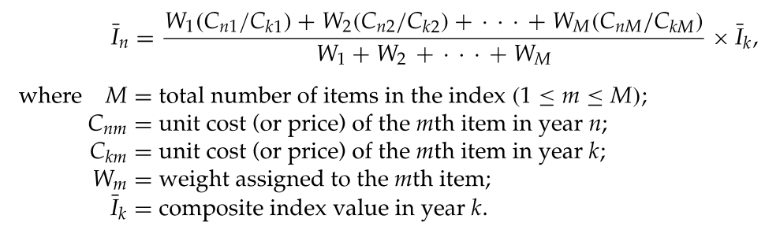
Estimating Techniques (Models) Indexes (cont’d)
Indexes can be created for a single item or for multiple items.
The developer of an index can assign different weights to the items in the index according to their contribution to total cost. For example, a general weighted index is given by

Slide 27
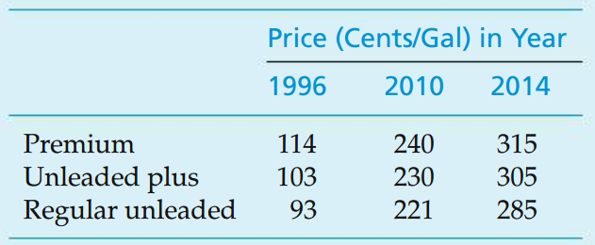
Example Weighted Index for Gasoline Cost
Based on the following data, develop a weighted index for the price of a gallon of gasoline in 2014, when 1996 is the reference year having an index value of 99.2.
The weight placed on regular unleaded gasoline is three times that of either premium or unleaded plus, because roughly three times as much regular unleaded is sold compared with premium or unleaded plus.

Slide 28
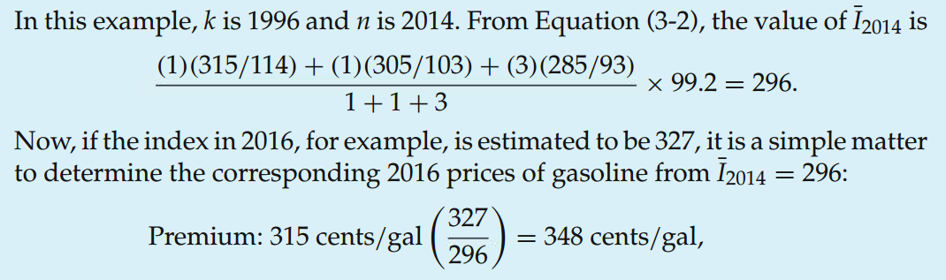

Solution Weighted Index for Gasoline Cost

Slide 29
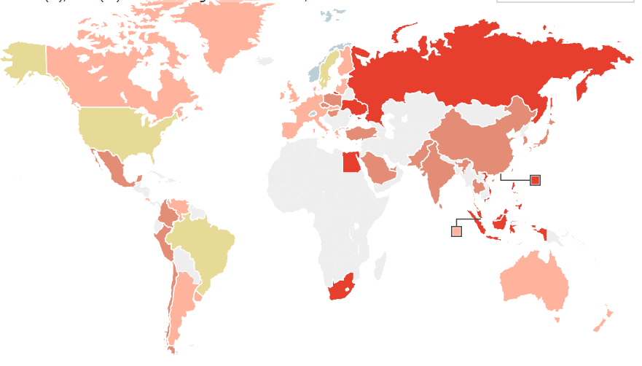
Comparing countries using indexes?
Notes:
Comparing 2 universities. Restaurants.

Slide 30

Big-Mac Index
Invented by The Economist in 1986 as an informal way of measuring the purchasing power parity (PPP) between two currencies and provides a test of the extent to which market exchange rates result in goods costing the same in different countries.
It "seeks to make exchange-rate theory a bit more digestible".
http://www.economist.com/content/big-mac-index

Slide 31
Example Big-Mac Index
Using figures in July 2008;
the price of a Big Mac was $3.57 in the United States (varies by store)
the price of a Big Mac was £2.29 in the United Kingdom (varies by region)
the implied purchasing power parity was $1.56 to £1, that is $3.57/£2.29 = 1.56
this compares with an actual exchange rate of $2.00 to £1 at the time (2.00-1.56)/1.56 = 28%
the pound was thus overvalued against the dollar by 28%

Slide 32
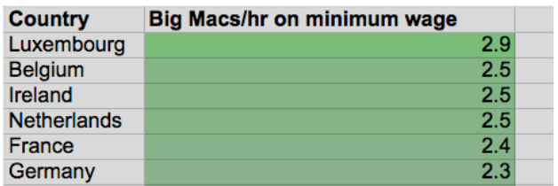
Example Comparing the minimum wage across Europe using the price of a Big Mac
Comparing Portugal's minimum wage to other countries in Europe (The Guardian, 2014)
https://www.theguardian.com/news/datablog/2014/sep/25/comparing-the-minimum-wage-across-europe-using-the-price-of-a-big-mac
…
…

Slide 33
Estimating Techniques (Models) Unit technique
The unit technique is one that is widely known and understood
A “per unit factor” is used, along with the appropriate number of units, to find the total estimate of cost.
An often used example is the cost of a particular house. Using a per unit factor of, say, $120 per square meter, and applying that to a house with 3,000 square meter, results in an estimated cost of $120 x 3,000 = $360,000. This techniques is useful in preliminary estimates, but using average costs can be very misleading

Slide 34
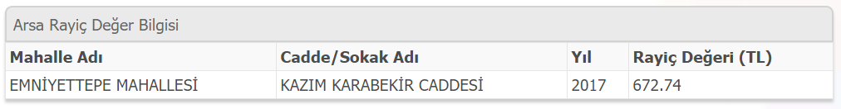
Example – Land Current Value in Eyüp Unit Technique
https://www.turkiye.gov.tr/eyup-belediyesi-arsa-rayic
Hence, a 300 m² land in this region has an estimated cost of 300 m² x 672.74 ₺/m² = 201,822 ₺

Slide 35
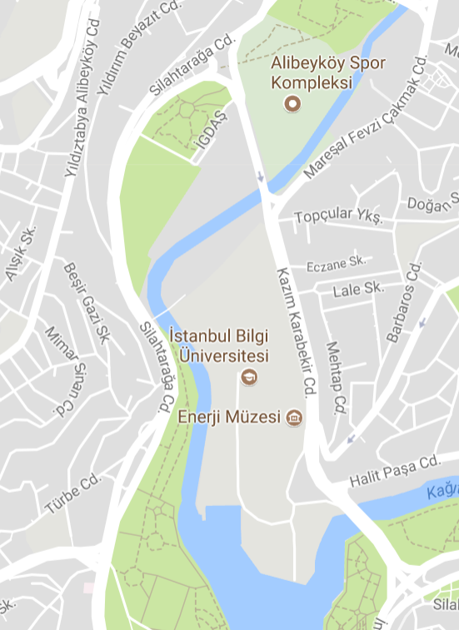
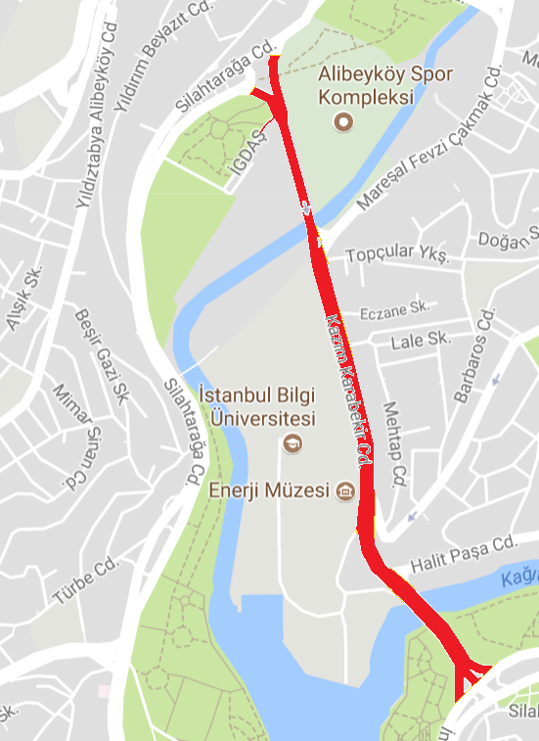
Estimating Techniques (Models) Unit technique (cont'd)
This technique is useful in preliminary estimates, but using average costs can be very misleading

Slide 36

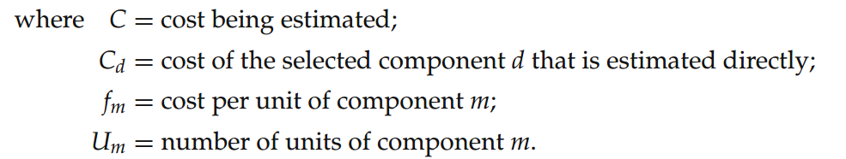
Estimating Techniques (Models) Factor technique
An extension of the unit technique where the products of several quantities are summed and then added to components estimated directly

Slide 37
Example Factor technique
Suppose that we need a slightly refined estimate of the cost of a house consisting of 2,000 square meters, two porches, and a garage.
Using a unit factor of $85 per square meter, $10,000 per porch, and $8,000 per garage for the two directly estimated components, we can calculate the total estimate as
($10,000 × 2) + $8,000 + ($85 × 2,000) = $198,000

Slide 38
Parametric Cost Estimating
Parametric cost estimating is the use of historical cost data and statistical techniques (e.g., linear regression) to predict future costs.
Parametric models are used in the early design stages to get an idea of how much the product (or project) will cost, on the basis of a few physical attributes (such as weight, volume, and power)

Slide 39
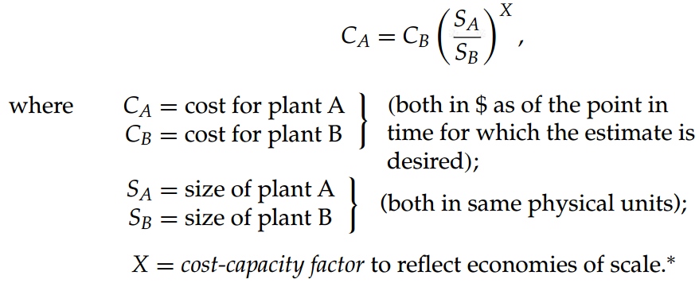
Parametric Cost Estimating Power-Sizing Technique
Also referred to as exponential model
Frequently used for developing capital investment estimates for industrial plants and equipment.

Slide 40
Parametric Cost Estimating Power-Sizing Technique (cont'd)
X = cost-capacity factor to reflect economies of scale.
X < 1
indicates decreasing economies of scale
each additional unit of capacity costs less than the previous unit
X > 1
indicates increasing economies of scale
each additional unit of capacity costs more than the previous unit
X = 1 indicates a linear cost relationship with size.
Notes:
Examples

Slide 41
Example 1 Power-Sizing Model for Cost Estimating
Suppose that an aircraft manufacturer desires to make a preliminary estimate of the cost of building a 600-MW fossil-fuel plant for the assembly of its new long distance aircraft. It is known that a 200-MW plant cost $100 million 20 years ago when the approximate cost index was 400, and that cost index is now 1,200. The cost-capacity factor for a fossil-fuel power plant is 0.79.

Slide 42
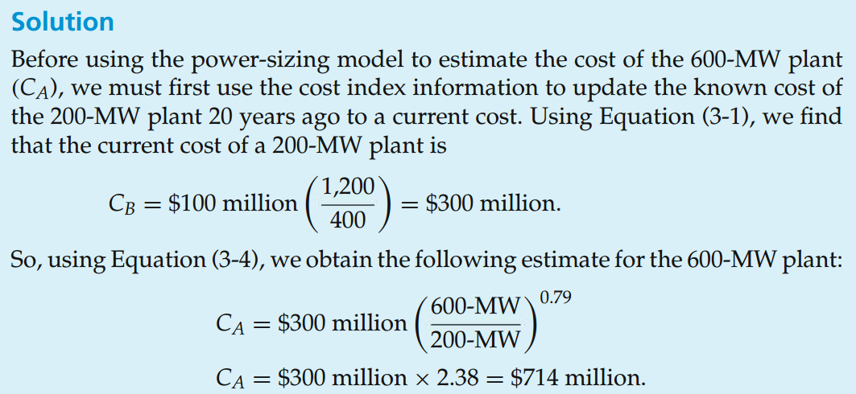
Solution 1 Power-Sizing Model for Cost Estimating

Slide 43
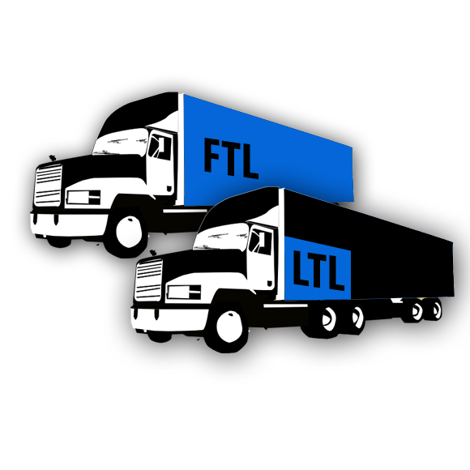
Example 2 Power-Sizing Model for Cost Estimating
Acme Logistics provides “Less than truck load” (LTL) services throughout the U.S. They have several hubs where they use cross-docking to move goods from one trailer to another. Acme built its last hub 10 years ago, and it had 36 dock doors. The cost index at that time was 140, and the total cost was $6 million. Acme plans a new hub that will have 48 dock doors. The cost index now is 195, and Acme will use a capacity factor of 0.82. What is the estimated cost of the new hub?

Slide 44
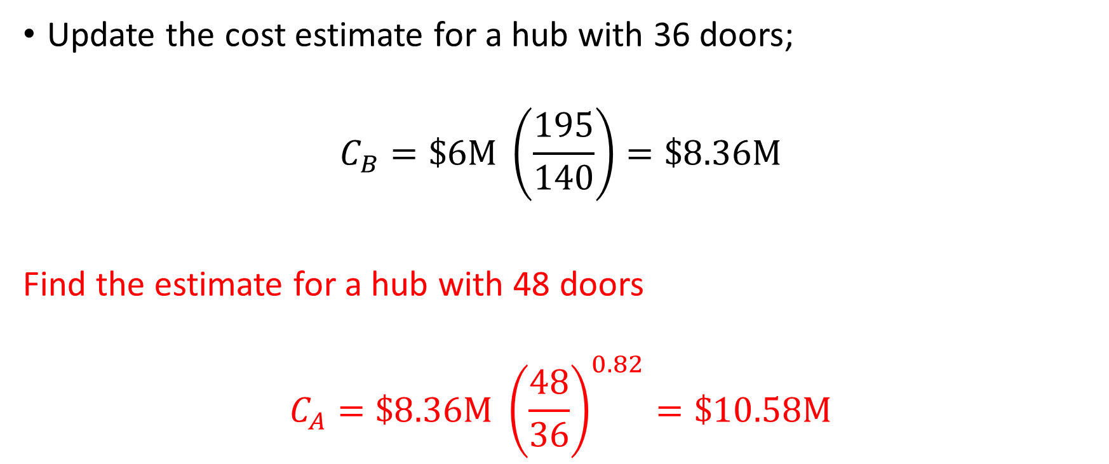
Solution 2 Power-Sizing Model for Cost Estimating
Update the cost estimate for a hub with 36 doors;
$$C_{B}=\$6M \left(\frac{195}{140}\right)=\$8.36M$$
Find the estimate for a hub with 48 doors
$$C_{A}=\$8.36M {\left(\frac{48}{36}\right)}^{0.82}=\$10.58M$$

Slide 45
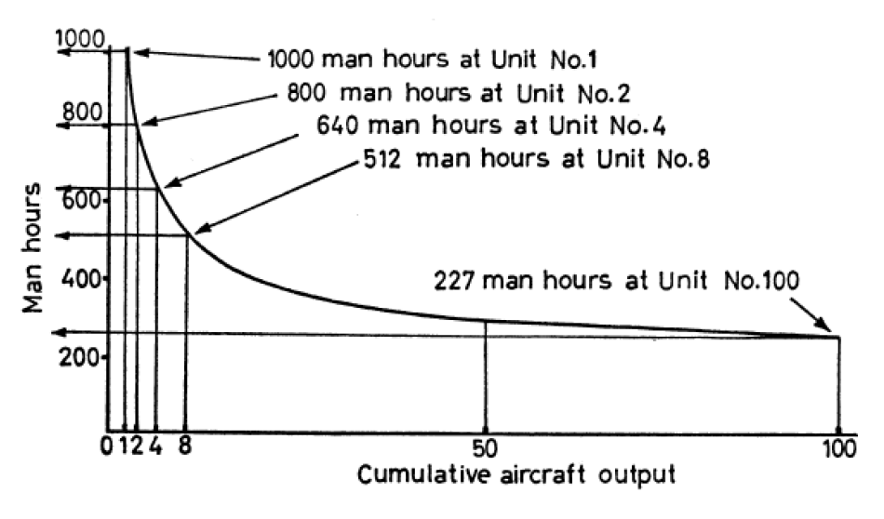
Parametric Cost Estimating Learning and Improvement
A learning curve reflects increased efficiency and performance with repetitive production of a good or service.
The concept is that some input resources decrease, on a per output-unit basis, as the number of units produced increases.

Slide 46
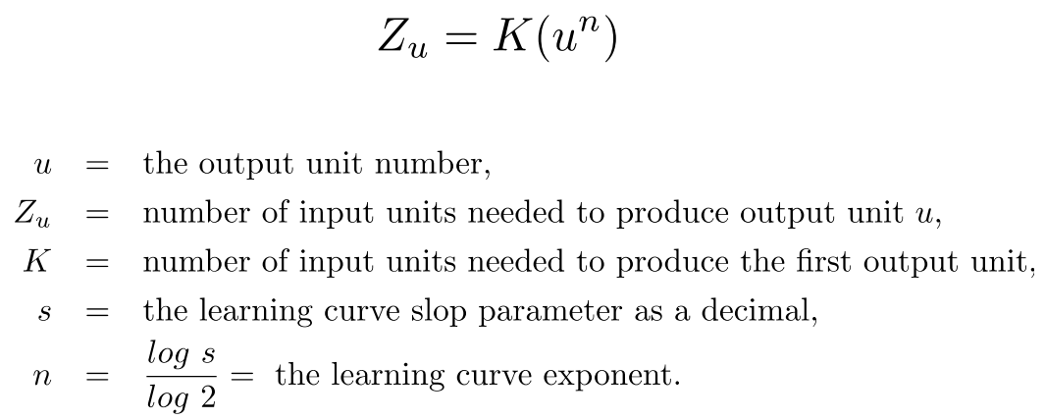
Parametric Cost Estimating Learning Curve
Most learning curves assume a constant percentage reduction occurs as the number of units produced is doubled

Slide 47
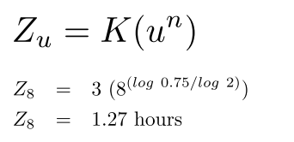
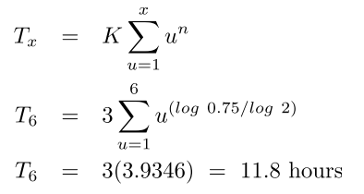
Example Learning and Improvement
Assume the first unit of production required 3 hours time for assembly. The learning rate is 75%. Find
the time to assemble the 8th unit, and
the time needed to assemble the first 6 units.

Slide 48
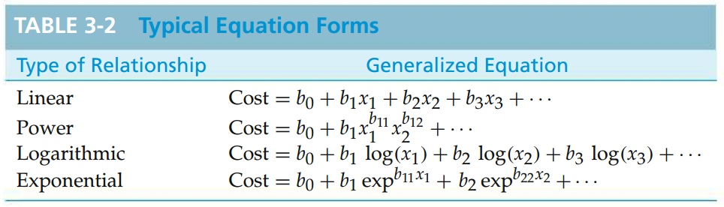
Parametric Cost Estimating Developing a Cost Estimating Relationship (CER)
A cost estimating relationship (CER) describes the cost of a project as a function of design variables
There are four basic steps in developing a CER.
Problem definition
Data collection and normalization
CER equation development
Model validation and documentation

Slide 49
End of Chapter 3

